Slide 1
Methods 2 Classroom 9

Slide 2
TODAY
Optimization in one or multiple dimensions using R
Using optimization to fit linear models

Slide 3
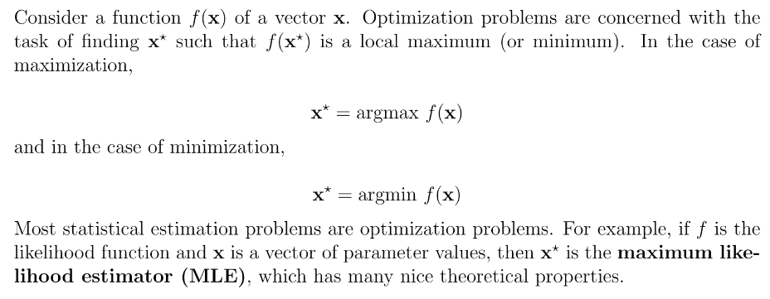
Optimization

Slide 4
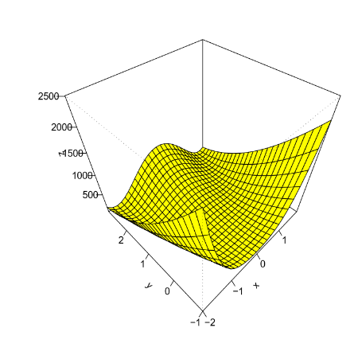
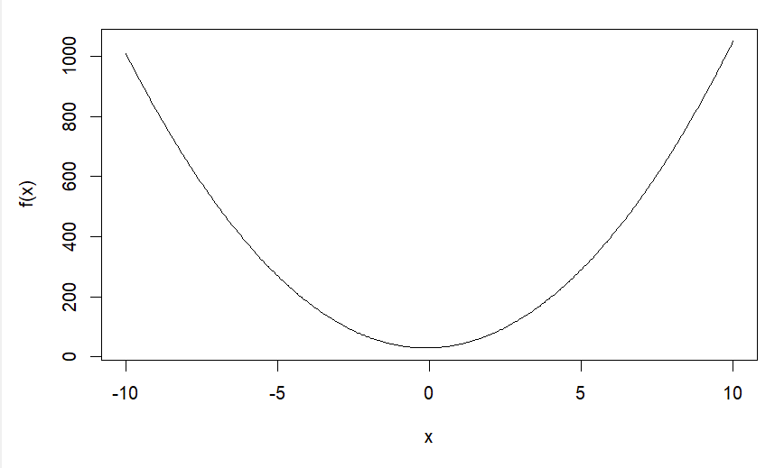
Optimization

Slide 5
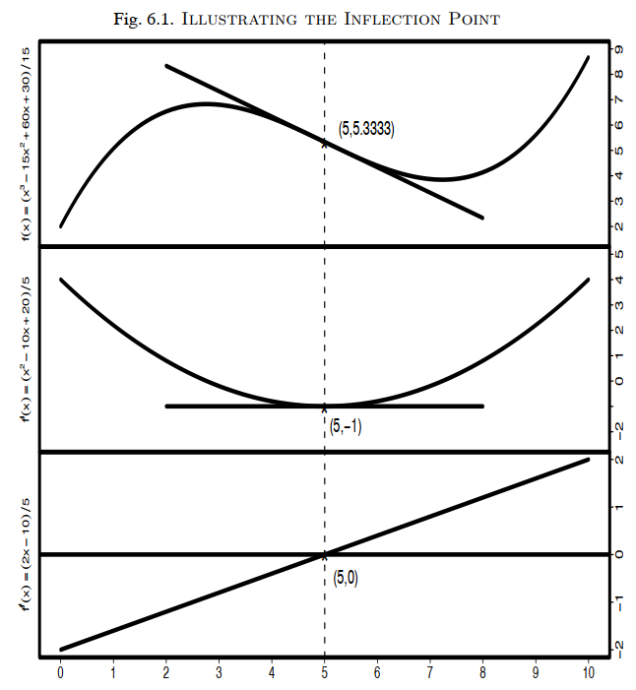
The second derivative rule
Local maximum if f’(x) = 0 & f’’(x) = negative
Local minimum if f’(x) = 0 & f’’(x) = positive

Slide 6
Exercises
Exercises specifically on the optim() function in R
Additional exercises in ROS
6.2
6.3
6.4
If you have more time:
8.1
8.3
Link to the exercise notebook: https://classroom.github.com/a/1yOuBRaF

